Slide 1
KL Divergence
2022-03-21

Slide 2
Authentication Problem: Find most similar data
X₂
-
-
-
+
Positive data
-
-
-
-
Negative data
-
-
-
-
-
-
-
-
-
-
-
-
-
-
-
is X positive or negative?
-
-
-
-
-
-
-
-
+
+
+
+
-
+
+
+
+
+
+
x
-
-
+
+
+
+
+
+
+
+
+
-
+
+
+
+
-
+
+
+
+
+
+
+
+
+
X₁

Slide 3
Authentication Problem: Find most similar data
X₂
-
-
-
+
Positive data
-
-
-
-
-
Negative data
-
-
-
-
-
-
-
-
-
-
-
-
-
-
-
-
-
-
-
-
-
-
is X positive or negative?
We can determine by calculating distance from X to positive and negative data.
Which pos/neg data? Use mean as representation of positive and negative data.
X will belong to the closest mean
-
+
+
+
+
-
+
+
+
+
+
x
+
+
+
-
-
+
+
+
+
+
+
+
+
+
+
-
-
+
+
+
+
+
+
+
+
+
+
+
X₁

Slide 4
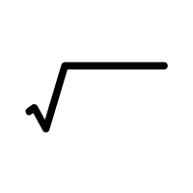
How to measure a distance?
Negative data
X₂
Testing data
Δx₂
Use Euclidean Distance
D = Δx₁² + Δx₂²
Δx₁
X₁

Slide 5

Euclidean Distance
Negative data
X₂
Testing data
q(q₁, q₂)
(q₂ – p₂)²
supposed the point named p(p₁, p₂) and q(q₁, q₂):
(q₁ - p₁)²
p(p₁, p₂)
$$Distance= \sqrt{{(q_{1}−p_{1})}^{2}+{(q_{2}−p_{2})}^{2}}$$
X₁

Slide 6
Euclidean Distance (3D)
X₂
Negative data
Testing data
q(q₁, q₂ , q₃)
supposed the point named p(p₁, p₂, p₃) and q(q₁, q₂, q₃):
X₁
$$Distance= \sqrt{{(q_{1}−p_{1})}^{2}+{(q_{2}−p_{2})}^{2}+{(q_{3}−p_{3})}^{2}}$$
p(p₁, p₂ , p₃)
X₃

Slide 7
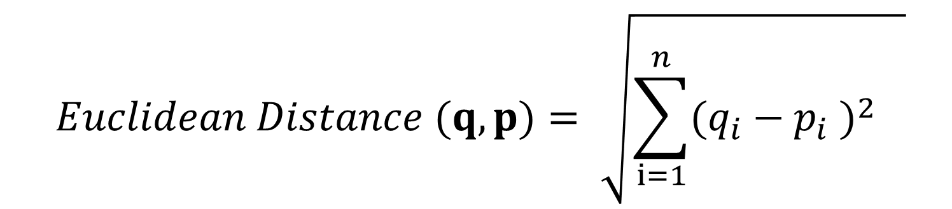
Euclidean Distance (Formal Equation)
$$Euclidean Distance (q, p)= \sqrt{{\sum_{i=1}^{n}{{(q_{i}−p_{i} )}^{2}}}^{}}$$
Note:
q = first point
p = second point
i = the number of dimensions

Slide 8
Apply Euclidean Distance to Histogram
What is the Euclidean distance between histogram P and histogram Q?

Slide 9
Apply Euclidean Distance to Histogram
Histogram P
Histogram Q
Bin Number | Bin Value | Probability
1 | 10 | 0
2 | 20 | 0
3 | 30 | 0.3
4 | 40 | 0.5
5 | 50 | 0.2
6 | 60 | 0
Bin Number | Bin Value | Probability
1 | 10 | 0
2 | 20 | 0
3 | 30 | 0
4 | 40 | 0.6
5 | 50 | 0.4
6 | 60 | 0
The number of bin is similar with the number of dimensions
Calculate Euclidian distance with 6 dimensions
What is the Euclidean Distance between histogram P and histogram Q?

Slide 10
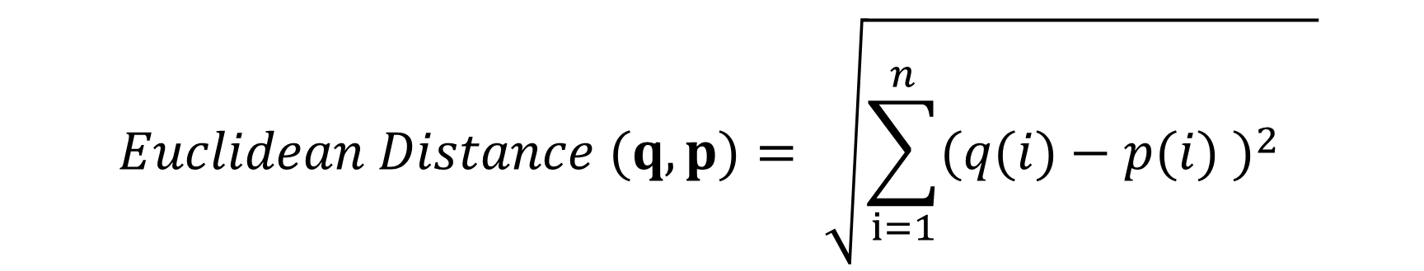
Euclidean Distance (for Histogram)
$$Euclidean Distance (q, p)= \sqrt{{\sum_{i=1}^{n}{{(q(i)−p(i) )}^{2}}}^{}}$$
Note:
q = first point
p = second point
i = the number of bins

Slide 11
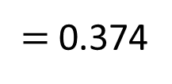

Apply Euclidean Distance to Histogram
Histogram P
Histogram Q
Bin Number | Bin Value | Probability
p(1) | 10 | 0
p(2) | 20 | 0
p(3) | 30 | 0.3
p(4) | 40 | 0.5
p(5) | 50 | 0.2
p(6) | 60 | 0
Bin Number | Bin Value | Probability
q(1) | 10 | 0
q(2) | 20 | 0
q(3) | 30 | 0
q(4) | 40 | 0.6
q(5) | 50 | 0.4
q(6) | 60 | 0
The number of bin is similar with the number of dimensions
Calculate Euclidian distance with 6 dimensions
$$Distance= \sqrt{{(q\left(1\right)−p\left(1\right))}^{2}+{(q\left(2\right)−p\left(2\right))}^{2}+ … +{(q(6)−p(6))}^{2}}$$
$$Distance= \sqrt{{(0)}^{2}+{(0)}^{2}+{(−0.3)}^{2}+{(0.1)}^{2}+{(0.2)}^{2}+{(0)}^{2}}$$
$$= \sqrt{0.14}$$
$=$0.374

Slide 12
Any alternative to Euclidean Distance?
We want to introduce KL Divergence based distance metric.
In some case, KL Divergence is suitable for probability distribution based variables (example: histogram based features)

Slide 13

KL Divergence: Intuition
Pick one of feature used in mobile authentication problem : startX

Slide 14
KL Divergence: Intuition
Pick one of feature used in mobile authentication problem : startX
1
2
StartX
Region | Number of Occurences | Normalized as Probability
1 | 4 | 0.666
2 | 2 | 0.333

Slide 15
KL Divergence: Intuition
Introducing information entropy : The degree of “uncertainty”
StartX example A:
StartX example B
1
2
1
2
Region | Number of Occurences | Normalized as Probability
1 | 9 | 0.9
2 | 1 | 0.1
Region | Number of Occurences | Normalized as Probability
1 | 5 | 0.5
2 | 5 | 0.5
A
B

Slide 16
KL Divergence: Intuition
Introducing information entropy : The degree of “uncertainty”
StartX example A:
StartX example B
1
2
1
2
Region | Number of Occurences | Normalized as Probability
1 | 9 | 0.9
2 | 1 | 0.1
Who is the “random” person?
B is more “random”
Region | Number of Occurences | Normalized as Probability
1 | 5 | 0.5
2 | 5 | 0.5
A
B

Slide 17
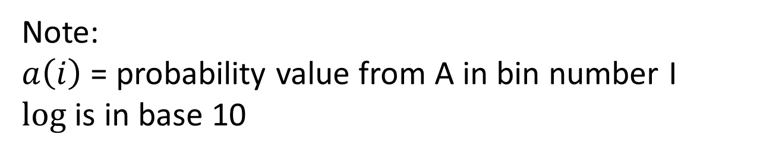
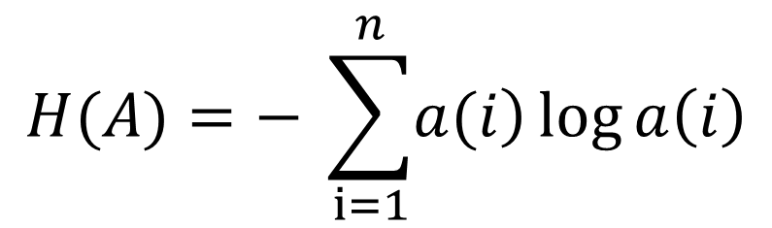
KL Divergence: Intuition
Introducing information entropy : The degree of “uncertainty”
Randomness = Unstable = Uncertain
B is more random, the information entropy in B is more than information entropy in A.
Entropy Equation for A:
$$H(A)=− \sum_{i=1}^{n}{\left.a(i\right)}\log{a\left(i\right)}$$
Note:
$a\left(i\right)$ = probability value from A in bin number I
$log$ is in base 10

Slide 18
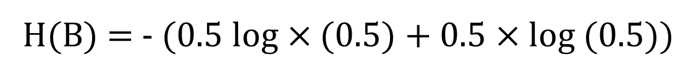
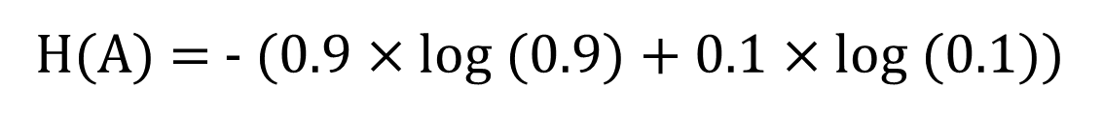
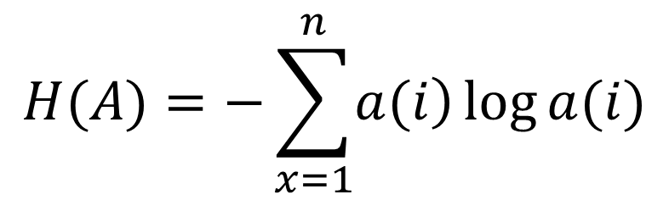
KL Divergence: Intuition
$$H(A)=−\sum_{x=1}^{n}{\left.a(i\right)}\log{a(i)}$$
StartX example A:
StartX example B
Region | Number of Occurences | Normalized as Probability
1 | 9 | 0.9
2 | 1 | 0.1
-> a(1)
H(A) = - (0.9 $×$ log (0.9) + 0.1 $×$ log (0.1))
-> a(2)
H(A) = - ((-0.0411)+(-0.1))
H(A) = 0.1411
Region | Number of Occurences | Normalized as Probability
1 | 5 | 0.5
2 | 5 | 0.5
H(B) = - (0.5 log$×$ (0.5) + 0.5 $×$log (0.5))
-> b(1)
H(B) = - ((-0.1505)+(-0.1505))
-> b(2)
H(B) = 0.301
B is more “random”

Slide 19
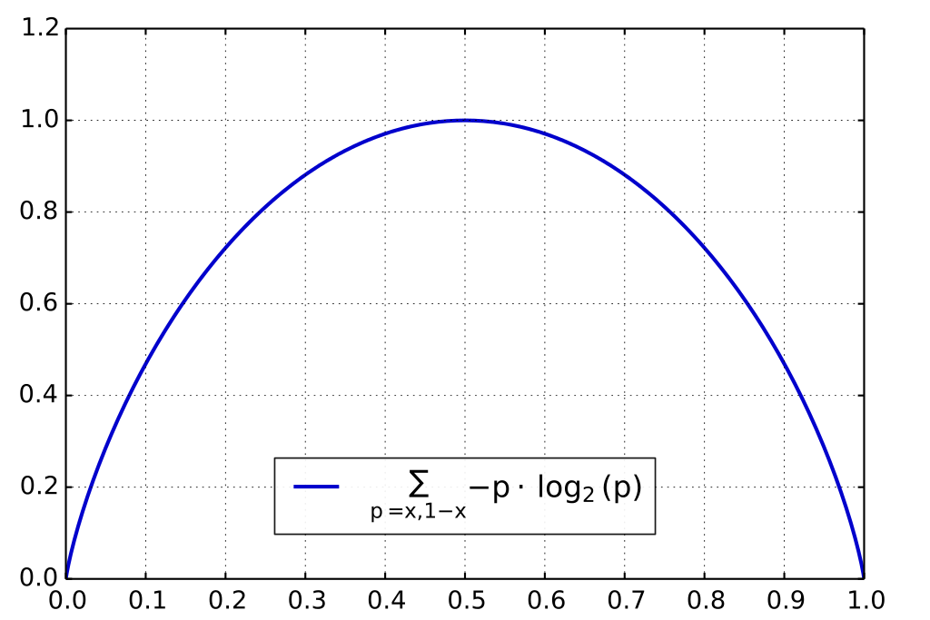
KL Divergence: Intuition
Entropy Graph

Slide 20
KL Divergence: Intuition
Relationship between entropy and user’s pattern
Unstable/random/uncertain user: high entropy
Stable user: low entropy

Slide 21
Cross Entropy
Introducing information entropy : The degree of “uncertainty”
Introducing cross-entropy: using other probability distribution to measure a probability distribution
Example: using a(i) to measure c(i)

Slide 22
Cross Entropy example:
StartX example A:
StartX example B
StartX example C (testing data):
Region | Number of Occurences | Normalized as Probability
1 | 9 | 0.9
2 | 1 | 0.1
Region | Number of Occurences | Normalized as Probability
1 | 6 | 0.6
2 | 4 | 0.4
What is cross entropy C to A?
Region | Number of Occurences | Normalized as Probability
1 | 5 | 0.5
2 | 5 | 0.5
What is cross entropy C to B?

Slide 23
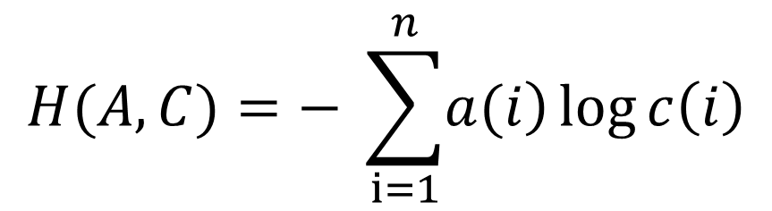
Cross Entropy
Introducing information entropy : The degree of “uncertainty”
Introducing cross-entropy: using other probability distribution to measure a probability distribution
Example: using a(x) to measure c(x)
Equation:
$$H(A, C)=− \sum_{i=1}^{n}{\left.a(i\right)}\log{c\left(i\right)}$$

Slide 24
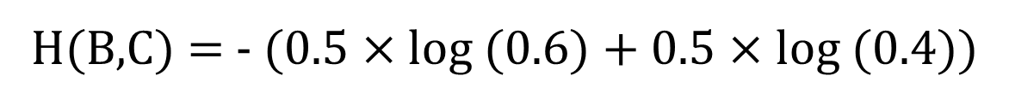
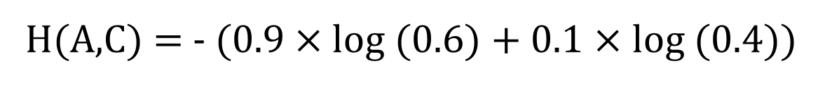
Cross Entropy example:
StartX example A:
StartX example B
StartX example C (testing data):
Region | Number of Occurences | Normalized as Probability
1 | 9 | 0.9
2 | 1 | 0.1
Region | Number of Occurences | Normalized as Probability
1 | 6 | 0.6
2 | 4 | 0.4
H(A,C) = - (0.9 $×$log (0.6) + 0.1 $×$ log (0.4))
H(A,C) = 0.2395
Region | Number of Occurences | Normalized as Probability
1 | 5 | 0.5
2 | 5 | 0.5
H(B,C) = - (0.5 $×$log (0.6) + 0.5 $×$ log (0.4))
H(B,C) = 0.3099

Slide 25
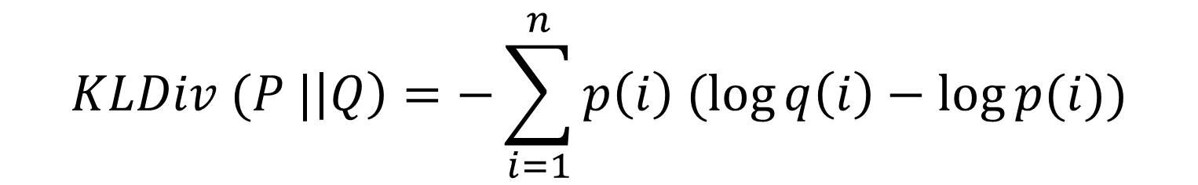
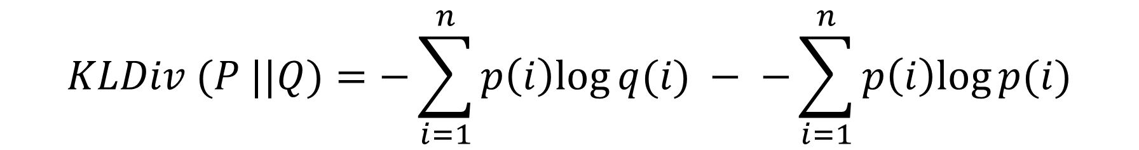
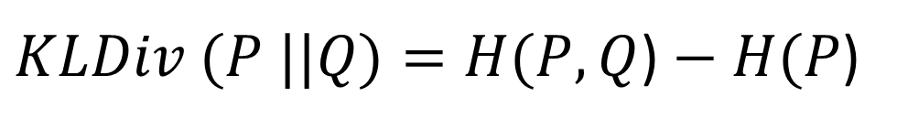
KL Divergence: Formal Equation
KL Divergence of probability distribution P to probability distribution Q is cross entropy (P,Q) - entropy of P
$KLDiv (P ||Q)=H(P, Q$) $− H(P$)
$$KLDiv (P ||Q)=−\sum_{i=1}^{n}{p\left(i\right)log{q(i)}} − −\sum_{i=1}^{n}{p\left(i\right)log{p(i)}}$$
$$KLDiv (P |\left|Q\right)=−\sum_{i=1}^{n}{p\left(i\right) (\log{q\left(i\right)}}−\log{p(i))}$$

Slide 26
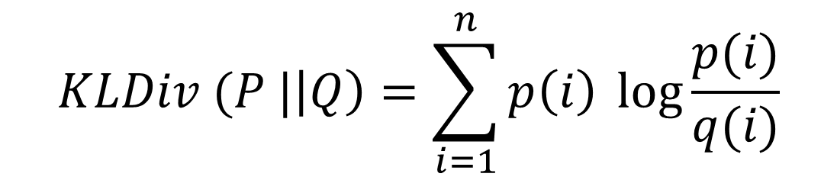
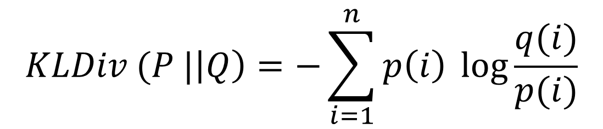
KL Divergence: Equation
$$KLDiv (P |\left|Q\right)=−\sum_{i=1}^{n}{p\left(i\right) \log{\frac{q(i)}{p(i)}}}$$
$$KLDiv (P |\left|Q\right)=\sum_{i=1}^{n}{p\left(i\right) \log{\frac{p(i)}{q(i)}}}$$

Slide 27
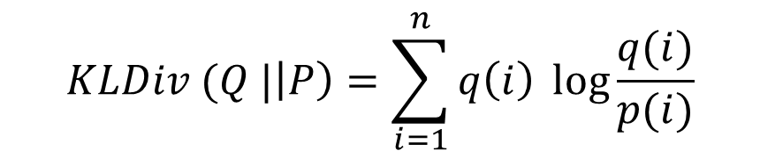
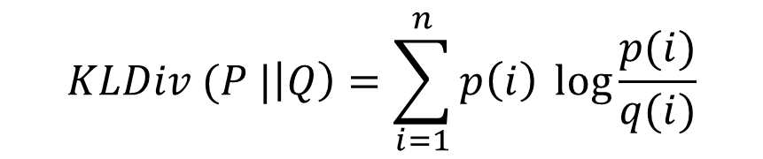
KL Divergence as distance measurement
KL Divergence can’t be used for distance measurement since
KL Div (P||Q) is not equal to KL Div (Q||P)
We formulate a Distance Metrics based on KL Divergence, let’s name it KLD-based distance
$$KLDiv (P |\left|Q\right)=\sum_{i=1}^{n}{p\left(i\right) \log{\frac{p(i)}{q(i)}}}$$
$$KLDiv (Q |\left|P\right)=\sum_{i=1}^{n}{q\left(i\right) \log{\frac{q(i)}{p(i)}}}$$
$$KLD based Distance (P, Q)= KLDiv (P |\left|Q\right)+ KLDiv (Q ||P)$$

Slide 28
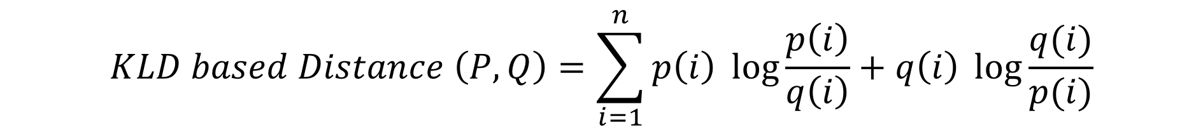
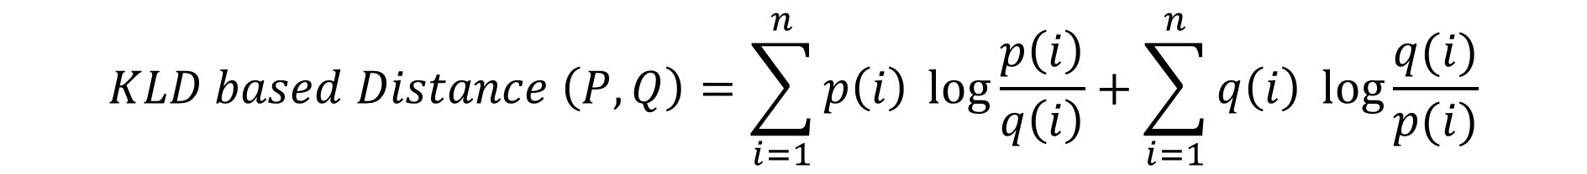
KLD-based distance Formal Equation
$$KLD based Distance (P, Q)= KLDiv (P |\left|Q\right)+ KLDiv (Q ||P)$$
$$KLD based Distance \left(P, Q\right)=\sum_{i=1}^{n}{p\left(i\right) \log{\frac{p\left(i\right)}{q\left(i\right)}}}+\sum_{i=1}^{n}{q\left(i\right) \log{\frac{q(i)}{p(i)}}}$$
$$KLD based Distance \left(P, Q\right)=\sum_{i=1}^{n}{p\left(i\right) \log{\frac{p\left(i\right)}{q\left(i\right)}}}+q\left(i\right) \log{\frac{q(i)}{p(i)}}$$

Slide 29
KLD-based distance vs Euclidean distance
Same results
Usually, if using Euclidean Distance, C is closer to B (smaller distance) than C to A, using KLD will produce the same.
Except in special case:

Slide 30
KLD-based distance vs Euclidean distance: special case
StartX example A (very stable):
StartX example B (random user)
StartX example C (between stable and random):
Region | Number of Occurences | Normalized as Probability
1 | 98 | 0.98
2 | 2 | 0.02
Region | Number of Occurences | Normalized as Probability
1 | 74 | 0.74
2 | 26 | 0.26
C is belong to user A or B?
Region | Number of Occurences | Normalized as Probability
1 | 50 | 0.5
2 | 50 | 0.5

Slide 31
Intuition
Test data:
in between A and B
Stable user
Random user
1
2
1
2
1
2
C is belong to user A or B?
A
C
B

Slide 32
KLD-based distance vs Euclidean distance: special case
Euclidean distance Result
C to A | C to B
0.3394 | 0.3394
Euclidean distance can’t determine

Slide 33
KLD-based distance vs Euclidean distance: special case
Euclidean distance Result
KLD-based distance result
C to A | C to B
0.3394 | 0.3394
C to A | C to B
0.2966 | 0.1090
Using KLD, C is more likely belong to B (closer distance)
Intuition: Because A is very stable user (low probability to be unstable), so C is likely belong to B

Slide 34
KL Divergence vs Euclidean Distance
B
KLD based distance will determine C belong to B
C, using KLD
C, using Euclidean distance
-
-
Euclidean
A
KLD based
probability
B
C
A

Slide 35
KLD-based distance vs Euclidean distance: conclusion
KLD-based distance considering the “randomness” of user’s pattern.
Based on our real data, the stability / instability of user is important factor for authentication
In our research field (Behavior based smartphone authentication), the instability of a user is also an important factor. That’s why, sometimes we prefer to use KLD-based distance rather than Euclidean Distance.

